Slide 1
19CSE205 Program Reasoning Propositional Logic
Dr.S.Padmavathi
CSE, Amrita School of Engineering
Coimbatore

Slide 2
Example
If the train arrives late and there are no taxis at the station, then John is late for his meeting.
John is not late for his meeting.
The train did arrive late.
Therefore, there were taxis at the station.
How to represent this as a formula?
Propositional logic:
Used to express sentence in such a way to bring out logical structure.

Slide 3
Logical structure
If the train arrives late and there are no taxis at the station, then John is late for his meeting.
John is not late for his meeting. The train did arrive late. Therefore, there were taxis at the station.
P- the train is late
Q - there are taxis at the station
R- John is late for his meeting
If P and not Q, then R.
Not R. P. Therefore Q.

Slide 4
Propositional Logic
Propositions or declarative sentences:
Statements or sentences which can be True or False
Example: sum of 3 and 5 equals 8. (T/F)
Every even natural number >2 is a sum of 2 prime numbers (T/F)
Examples that are not propositions
What time is it? – answer in Numeric
x + 1 = 2 – involves solution of x – Number theory
x + y > z – involves variables. PL if values of x,y,z is given
x*x = 64 -> x = 8 V x = -8–PL augmented with number theory.

Slide 5
Statements
Atomic or indecomposable statements are taken as Proposition. Eg. P,Q,R
Complex sentences are represented in a compositional way.
Logical connectives are used in compounding propositions.
A valuation or model of a formula φ is an assignment of each propositional atom in φ to a truth value.

Slide 6
Logical Connectives of PL Conjunction: A ^ B
Example 1:
I scored first class
And
Secured distinction
A
B
A ^ B
T
T
T
T
F
F
Example 2:
X is largest of 3 numbers
(x > y) ^ (x > z)
F
T
F
F
F
F
A ^ B ≡
A && B

Slide 7
Disjunction: A V B
Example 1:
You can wear Chudithar
Or
Saree for carnival.
A
B
A V B
T
T
T
T
F
T
Example 2:
A vowel
(p==‘a’)V (p==‘e’)V (p==‘i’)V
(p==‘o’)V (p==‘u’)
F
T
T
F
F
F
A V B ≡
A || B

Slide 8
Implication: A → B
Example 1:
If Today is Sunday
Then Library is Closed
A
B
A → B
T
T
T
T
F
F
Example 2:
marks < 50 → grade == F
F
T
T
F
F
T
&&
grade == F → marks < 50
A → B ≡
not(A) || B
Reference: Dr.Bharat Jayaraman, Unviversity of Buffalo, CSE449-459 Software verification course, Spring 2020.

Slide 9
Implication
A → B (if- then)
B is the logical consequence of A
A is called the assumption of A → B
B is called as the conclusion of A → B
View logical conditional as a contract
F → T does not violate the contract
The only time the contract is broken is when T → F

Slide 10
Double Implication: A ↔ B
Example :
You can take a flight iff
you buy an airline ticket
A
B
A ↔ B
T
T
T
T
F
F
True only if you do both or neither
Doing only one or the other
makes the proposition false
F
T
F
F
F
T
A ↔ B ≡
A→B and B →A (Biconditional)
.

Slide 11
Compound statements
Priority:
Negation (¬)
Conjunction(^)
Disjunction(V)
Implication(→)
Double Implication(↔)
Implication is right associative
A | ¬ A
T | F
F | T

Slide 12
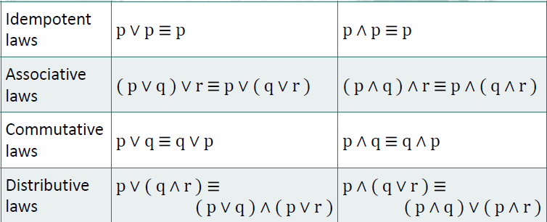
Laws of Propositional Logic

Slide 13
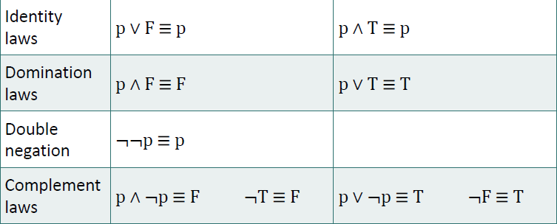
Laws of Propositional Logic

Slide 14
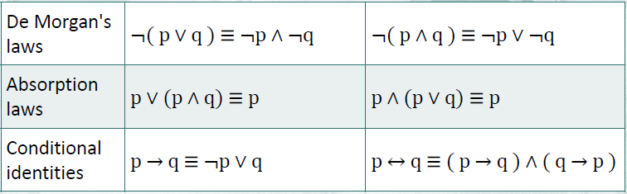
Laws of Propositional Logic

Slide 15
Natural deduction
Collection of proof rules which infer formulas from other
Premises-set of formula φ1, φ2,φ3, . . . , φn,
Conclusion -another formula, ψ,
Natural deduction: By applying proof rules to the premises, eventually obtain the conclusion
(ie) φ1, φ2, . . . , φn ├ ψ expression is called sequent
which means: from the premises φ1, φ2, . . . , φn, we may conclude ψ

Slide 16
Sequent for the example
If the train arrives late and there are no taxis at the station, then John is late for his meeting.
John is not late for his meeting. The train did arrive late. Therefore, there were taxis at the station.
P- the train is late ;Q - there are taxis at the station; R- John is late for his meeting
Logical structure:
If P and not Q, then R. Not R. P. Therefore Q.
Premises: P ∧￢Q → R, ￢R, P (φ1, φ2,φ3 )
Conclusion: Q (ψ)
Sequent: P ∧￢Q → R, ￢R, P ├ Q.

Slide 17
Construction of proof
Sequent is valid, if proof for it can be found
Given Premises and conclusion, constructing proof is a process which tries to derive the steps in between
proof rules should be carefully chosen
p for ‘Gold is a metal.’ and q for ‘Silver is a metal,
we won’t be able to show the sequent p, q ├ p ∧￢q
Sequent infer that ‘Gold is a metal whereas silver isn’t.’

Slide 18
Construction of proof for Example
1 p∧ ￢ q → r premise
2 ￢ r premise
3 p premise
4 ￢ q assumption
5 p∧ ￢ q ∧ i 3, 4
6 r →e 1, 5
7 ⊥ ￢e 6, 2
8 ￢￢q ￢i 4−7
9 q ￢￢e 8 (Conclusion)

Slide 19
Provable equivalence
Let φ and ψ be formulas of propositional logic.
We say that φ and ψ are provably equivalent iff the sequents φ ├ ψ and ψ ├ φ are valid. It is denoted by φ ┤├ ψ.
(ie) there is a proof of ψ from φ and another one going the other way around.
Examples
p → q ≡ ￢q → ￢p
p → q ≡ ￢p ∨ q
p ∧ q → p ≡ r ∨￢r
p ∧ q → r ≡ p → (q → r).

Slide 20
Propositional logic as a formal language
Logical formula φ with valid sequent ├ φ is theorem.
Deductive method
transform any proof of φ1, φ2, . . . , φn ├ ψ into a proof of the theorem
φ1 → (φ2 → (φ3 → (· · ·→(φn → ψ) . . . )))
by ‘augmenting’ the previous proof with n lines of the rule →i applied to φn, φn−1,. . . , φ1 in that order.
Semantics method
based on looking at the ‘truth values’ of the atomic formulas in the premises and the conclusion; and at how the logical connectives manipulate these truth values
Semantic Entailment:
If, for all valuations in which all φ1, φ2, . . . , φn evaluate to T, ψ evaluates to T as well, we say that φ1, φ2, . . . , φn ╞ ψ.

Slide 21
Satisfiability and Validity
Given a formula φ in propositional logic, we say that φ is satisfiable if it has a valuation in which it evaluates to T.
For example, the formula p ∨ q → p is satisfiable since it computes T if we assign T to p.
Clearly, p ∨ q → p is not valid.
Thus, satisfiability is a weaker concept since every valid formula is by definition also satisfiable but not vice versa.

Slide 22
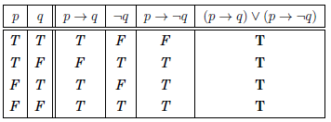
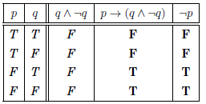
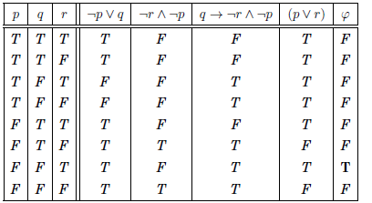
Satisfiable vs Valid vs Equivalent

Slide 23
Limitations of Propositional Logic
Propositional logic is not sufficient to express many concepts
Example :
Given the statements:
“All men are mortal”
“Socrates is a man”
It follows that: “Socrates is mortal”
This can’t be represented in propositional logic
Need formalism to express objects (terms) and properties of objects

Slide 24
Limitations of Propositional Logic
Example :
Statements such as “x is a perfect square” are not propositions
The truth value depends on the value of x
i.e., the truth value is a function of x
We need a more powerful formalism: Predicate logic

Slide 25
Limitations of propositional logic
Propositional logic dealt quite satisfactorily with sentence components like not, and, or and if . . . Then
What can we do with modifiers like there exists. . . , all . . . , among . . . and only . . .?
fails to reflect the finer logical structure
Solution :
predicate logic also called first-order logic.
a set of predicate symbols P, a set of function symbols F and a set of constant symbols C.

